Slide 1
End-to-End Neural Network for Direct Portfolio Weight Optimization
Machine Learning Project
Muhammad Zaid Maqsood
May 2, 2026

Slide 2
Overview
This project builds an end-to-end ML framework that directly learns portfolio weights from market data, improving risk-adjusted performance and allocation stability over traditional approaches in Finance.

Slide 3
Problem & Objective
Problem with Traditional Approaches
Objective
Research Question
Return prediction is noisy
Two-step models (predict returns & then optimize weight) amplify errors
Fail to capture non-linear and temporal dynamics
Learn portfolio weights directly from data
Optimize at portfolio level by maximizing return, controlling risk and ensuring allocation stability (low turnover)
Can end-to-end ML deliver better risk-adjusted performance than Mean-Variance?

Slide 4
Data & Evaluation Metrics
Data
10 years of daily ETFs (Exchange-Traded Fund) data via yfinance
Diversified assets: Equities, International markets, Bonds, Commodities, Real estate, Energy
Engineered features and Model Inputs: Daily returns, Lagged returns, Volatility, Moving averages, Momentum
Evaluation Metrics
Return: Annualized return
Risk: Volatility, Maximum Drawdown
Risk-adjusted: Sharpe ratio, Calmar Ratio
Stability: Portfolio turnover
Comparison: MLP vs LSTM vs Mean-Variance benchmark
Loss Function
Loss = - Sharpe_Ratio* + λ1xTurnover + λ2xDrawdown
* Sharpe Ratio = Excess Return / Volatility ⇒ Captures risk and return
Notes:
Sharpe Ratio = Excess Return / Volatility

Slide 5
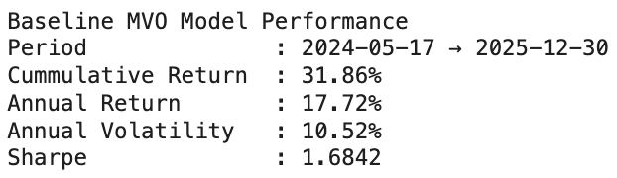
Models & Approach
Baseline Model: Mean-Variance portfolio (Markowitz)
Computes optimal weights using expected returns and covariance
Model 1: MLP (Feedforward Neural Network)
Input: Engineered features (returns, volatility, momentum, lagged signals)
Output: Portfolio weights across ETFs
This model captures non-linear relationships across assets and does not explicitly model time dependency
Model 2: Long Short-Term Memory (LSTM / Sequence Model)
Input: Sequential time-series features (lookback window of historical signals)
Output: Portfolio weights across ETFs
This model captures temporal dependencies and market dynamics and is designed for sequential decision learning in financial data

Slide 6
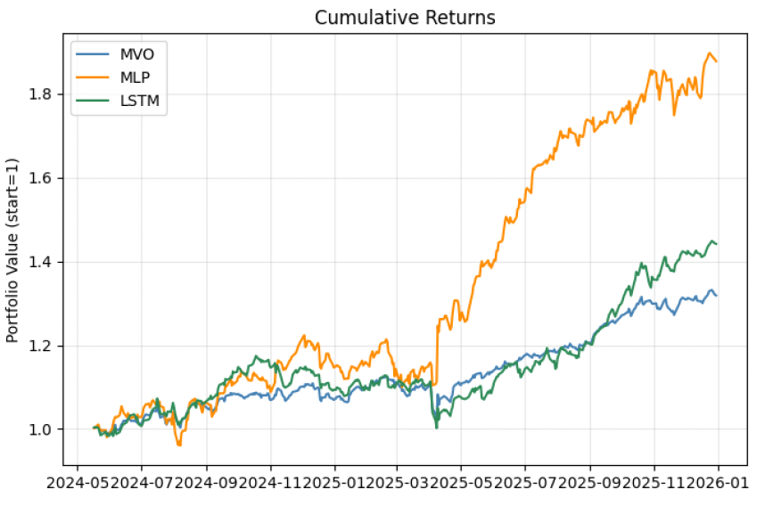
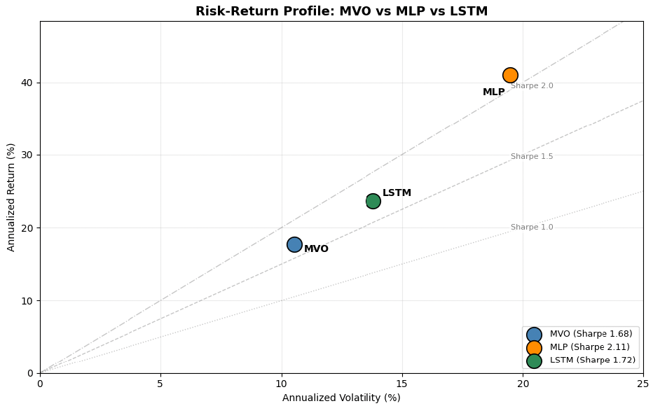
Evaluation & Insights
Finding 1
MLP achieved the highest cumulative return at 87.76%
Finding 2
MLP achieved the strongest Sharpe ratio at 2.1061
Finding 3
How robust is performance under drawdowns?

Slide 7
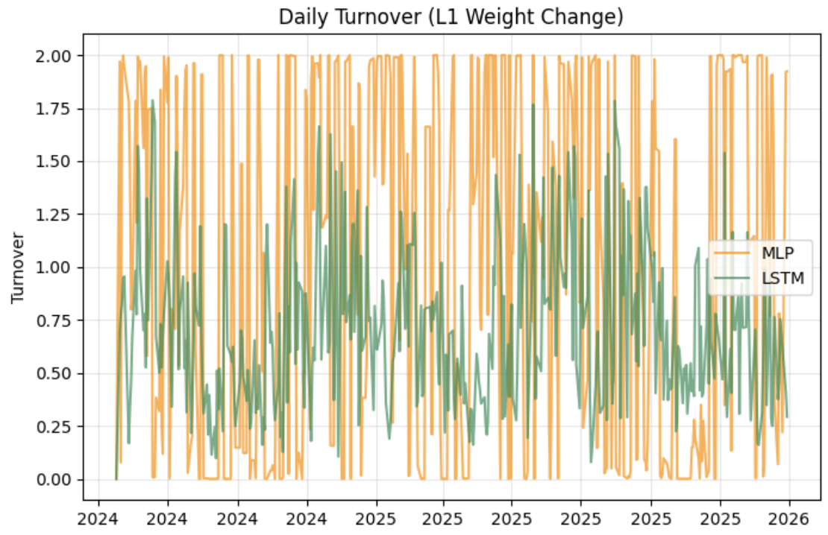
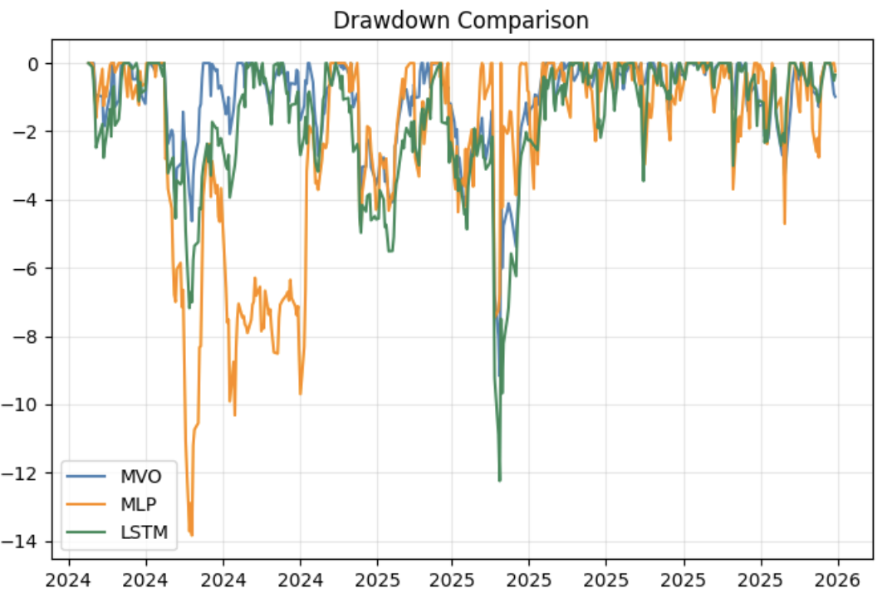
Evaluation & Insights
Finding 3
MVO remained the most conservative model with the lowest drawdown at -9.17%.
Finding 4
LSTM improved return and Sharpe ratio relative to MVO, but had the largest drawdown among selected models.

Slide 8
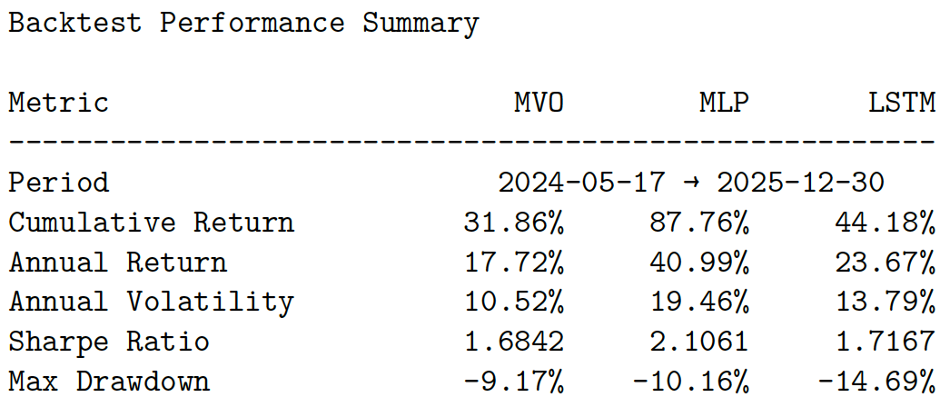
Conclusion
Thank you!
This project demonstrates how end-to-end machine learning can directly learn portfolio allocations, improving risk-adjusted returns and stability compared to traditional optimization methods.

